Slide 1
Holmusk Data Science Project Presentation
Meihan LIU
06 Jun 2018

Slide 2
Outlines
  Exploratory data analysis
  Data cleaning and preparation
  Feature generation
  Data analysis
  Conclusions

Slide 3
Exploratory data analysis (EDA)
Data columns Data shape
bill_amount.csv (13600, 2)
bill_id, amount
bill_id.csv (13600, 3)
bill_id, patient_id date_of_admission
clinical_data.csv (3400, 26)
patient_id, date_of_admission, date_of_discharge,
medical_history_1, … medical_history_7,
preop_medication_1, … preop_medication_6,
symptom_1, … symptom_5,
lab_result_1, … lab_result_3,
weight, height
demographics.csv (3000, 5)
patient_id, gender, date_of_birth,
race, resident_status,
Total 3000 patients
379 patients visited more than once
Sum the bill amount if the patient pay more than one bill in the same day
Notes:
Data self-contained

Slide 4
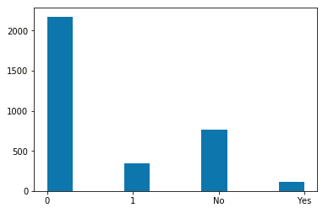
Exploratory data analysis (EDA) - clinical_data.csv
Number of unique values
patient_id 3000
date_of_admission 1450
date_of_discharge 1532
medical_history_1 2
medical_history_2 2
medical_history_3 4
medical_history_4 2
medical_history_5 2
medical_history_6 2
medical_history_7 2
preop_medication_1 2
preop_medication_2 2
preop_medication_3 2
preop_medication_4 2
preop_medication_5 2
preop_medication_6 2
symptom_1 2
symptom_2 2
symptom_3 2
symptom_4 2
symptom_5 2
lab_result_1 98
lab_result_2 148
lab_result_3 90
weight 522
height 35
Data types
patient_id object
date_of_admission object
date_of_discharge object
medical_history_1 int64
medical_history_2 float64
medical_history_3 object
medical_history_4 int64
medical_history_5 float64
medical_history_6 int64
medical_history_7 int64
preop_medication_1 int64
preop_medication_2 int64
preop_medication_3 int64
preop_medication_4 int64
preop_medication_5 int64
preop_medication_6 int64
symptom_1 int64
symptom_2 int64
symptom_3 int64
symptom_4 int64
symptom_5 int64
lab_result_1 float64
lab_result_2 float64
lab_result_3 float64
weight float64
height float64
Number of patients
Categorical
features
medical_history_3
Assumption: For medical_history, preop_medication and symptom features that have two values 0 and 1, we assume that 1 represents that the patients have this medical history, have taken this medication and have shown this symptom respectively, and 0 means the contrary.

Slide 5
Exploratory data analysis (EDA)
Exploratory data analysis (EDA) - demographics.csv
demographics.csv
Column Name Number of Unique Values Data Values
patient_id 3000
gender 4 'Female', 'f', 'Male', 'm'
race 6 'Indian', 'Chinese', 'Malay', 'chinese', 'India', 'Others'
resident_status 4 'Singaporean', 'Singapore citizen', 'PR', 'Foreigner
date_of_birth 2746

Slide 6
Outlines
  Exploratory data analysis
  Data cleaning and preparation
  Feature engineering
  Data analysis
  Conclusions

Slide 7
Data cleaning and preparation
Clean data according to EDA findings
  clinical_data.csv
  medical_history_2 and medical_history_5 has missing values, total 233 and 304 rows of NA values respectively
  medical_history_3 which has 4 values, which are 0, 1, no and yes, reduce to two, 1 <-> yes, 0 <-> on
  sum the amount spent for the unique 3400 combinations of patient_id and date_of_admission for clinical data
  demographics.csv
  gender has 4 values, should change f to female and m to male
  race, change to lower case, Indian == india, Chinese == Chinese
  resident_status, singaporean == Singapore citizen
Merge data and drop duplicate columns and rows

Slide 8
Outlines
  Exploratory data analysis
  Data cleaning and preparation
  Feature engineering
  Data analysis
  Conclusions

Slide 9
Feature engineering
Patients distribution over resident, race
Race | Resident_status | Population | Percentage
 | Foreigner | 94 | 4.4%
chinese | PR | 304 | 14.4%
 | Singaporean | 1517 | 71.8%
 | Foreigner | 13 | 4.4%
indian | PR | 40 | 13.6%
 | Singaporean | 242 | 82%
 | Foreigner | 26 | 4.1%
malaysian | PR | 99 | 15.7%
 | Singaporean | 504 | 80.1%
 | Foreigner | 10 | 6.2%
others | PR | 22 | 13.7%
 | Singaporean | 129 | 80.1%
Year of admission
  From Y2011 to Y2015
Length of stay (days)
Age at the time of admission
BMI
Citizenship_race

Slide 10
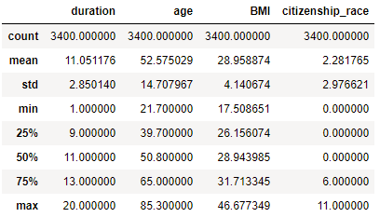
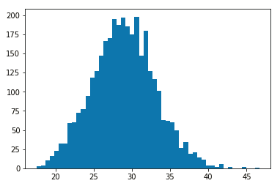
Feature engineering
Year of admission
  From Y2011 to Y2015
Length of stay (days)
Age at the time of admission
BMI
Citizenship_race
overweight
obese
Number of patients
BMI

Slide 11
Outlines
  Exploratory data analysis
  Data cleaning and preparation
  Feature engineering
  Data analysis
  Conclusions

Slide 12
Data analysis - Features correlation with cost
cost 1.000000
symptom_5 0.516789
resident_status 0.420373
citizenship_race 0.400176
race 0.329997
age 0.325521
medical_history_1 0.226518
symptom_3 0.183988
symptom_2 0.157819
weight 0.157511
medical_history_6 0.141640
BMI 0.140361
symptom_4 0.130236
symptom_1 0.128317
……
gender -0.057739
Top features have strong correlation with cost
symptom_5
resident_status
citizenship_race
Race
Age
We can examine them one by one

Slide 13
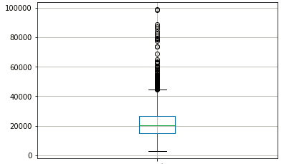
Data analysis – cost distribution
We can separate the data into 5 subsets
according to the boxplot:
outliers
data from the 3rd quartile to 4th quartile
data from the 2nd quartile to 3rd quartile
data from the 1st quartile to 2nd quartile
data from the 0th quartile to 1st quartile
The 5 subsets have 94, 756, 850, 850 and 850 samples respectively.
Then we can see how largely these top features drive the cost of different subsets.
Outliers
Cost

Slide 14
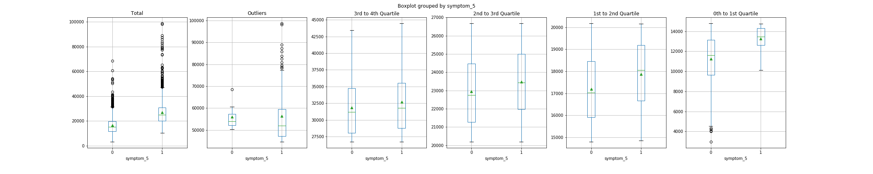
Data analysis – Symptom_5 versus Cost
Patients with symptom_5 generally spent more than these without symptom_5.
The cause of symptom_5 is not clear.
Cost
Cost versus symptom_5 for different subsets
The green triangle marks mean value.

Slide 15
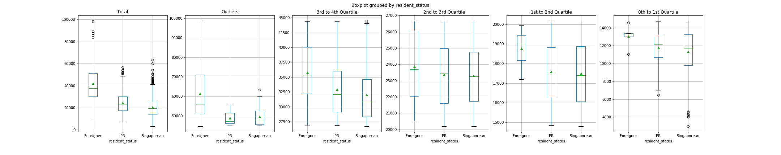
Data analysis – Resident status versus Cost
Foreigner spends more than PR and Singaporean
Singaporean spends the least
Cost
On average about 20000

Slide 16
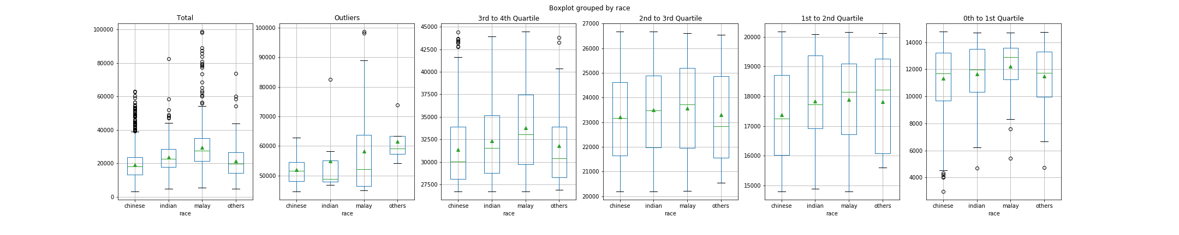
Data analysis – Race versus Cost
Chinese spends the least
Malaysian spends the most
Cost

Slide 17
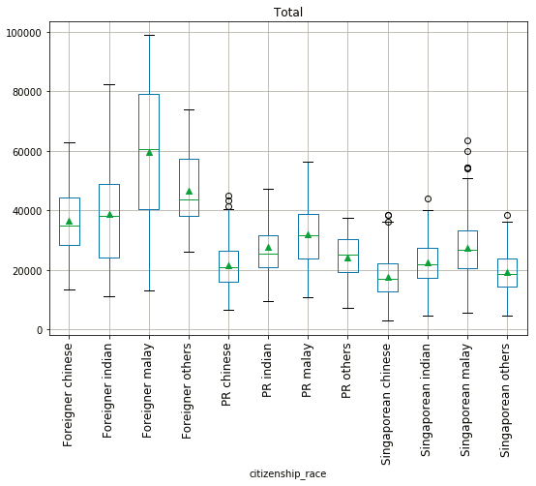
Data analysis – Citizenship_race versus Cost
Malaysian pays the most across different citizenship
What are the reasons account for this?

Slide 18
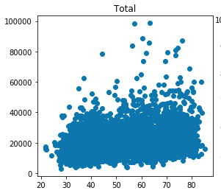
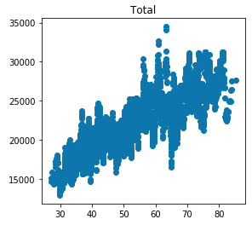
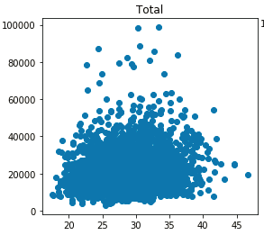
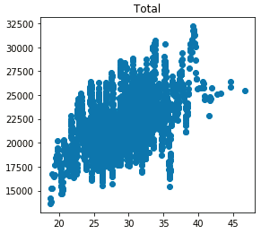
Data analysis – Age/BMI versus Cost
Rolling average of 20 samples
Overall trend of increasing cost as age/BMI increases, this is not obvious
Cost
Cost
Age
Age
overweight
obese
Number of patients
Cost
Cost
BMI
BMI
BMI

Slide 19
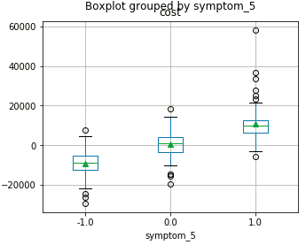
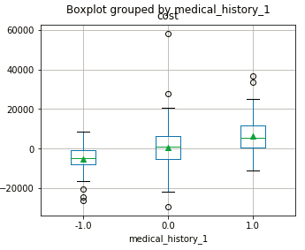
Data analysis – patients visit more than once
Remember that there are 379 patients visit hospital more than once
We can calculate the feature differences between visits for each patient
Cost difference
correlation with cost difference
symptom_5 0.728839
medical_history_1 0.312242
symptom_1 0.247311
symptom_3 0.241446
medical_history_6 0.225357
symptom_2 0.220279
……
lab_result_3 -0.050594
Cost depends positively on these features
Cost difference

Slide 20
Outlines
  Exploratory data analysis
  Data cleaning and preparation
  Feature engineering
  Data analysis
  Conclusions

Slide 21
Conclusions
Main factors drive the cost
symptom_5
Resident status
Future development
Collect more data
Stratified data split before modeling

Slide 22
Outlines
  Exploratory data analysis
  Data cleaning and preparation
  Feature engineering
  Data analysis
  Modeling
  Conclusions

Slide 23
A “brute-force” data modeling
Train/test split
The test data was used only for evaluating the trained model and was generated by randomly chosing 50 samples from the dataset.
Cross validation
  Random shuffle the data, then separate into 25 folds
Ensemble modeling
  Catboost uses an efficient method of encoding which is similar to mean encoding but reduces overfitting
  5 models with same hyperparameters were trained and made predictions on their respective test set
Model evaluation metric
  RMSE: root-mean-squared error
Train 3350 samples
Test 50 samples

Slide 24
Modeling results
Model | Training error | Validation error | Test error
1 | 663.31±31.47 | 1003.31±588.61 | 398.33
2 | 723.52±43.50 | 956.65±610.41 | 298.67
3 | 733.74±33.05 | 960.31±687.41 | 1597.11
4 | 618.19±39.83 | 931.12±589.15 | 213.67
5 | 895.81±46.10 | 1002.67±559.53 | 714.16
Average | 726.92±38.79 | 970.81±607.02 | 644.39
Overfitting
Different test error for different models
Higher training and validation error than test score and high test error for model 3 and 5, why?

Slide 25
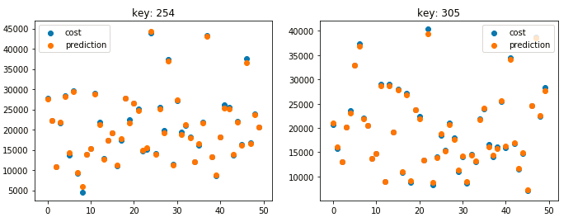
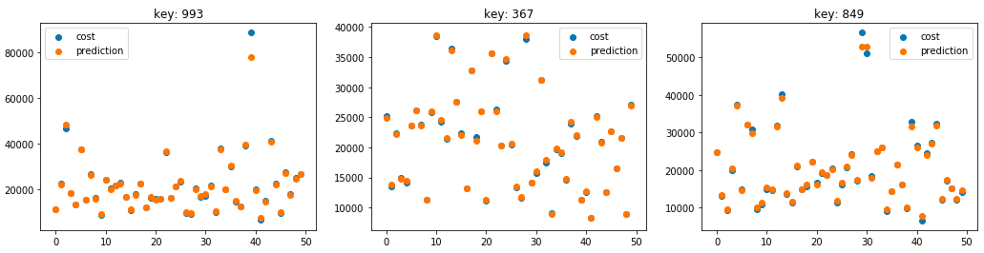
Comparision of prediction results versus test
Model 1
Model 2
Model 3
Model 4
Model 5

Slide 26
Modeling results
Model | Training accuracy score | Validation accuracy score | Test accuracy score
1 | 663.31±31.47 | 1003.31±588.61 | 398.33
2 | 723.52±43.50 | 956.65±610.41 | 298.67
3 | 733.74±33.05 | 960.31±687.41 | 1597.11
4 | 618.19±39.83 | 931.12±589.15 | 213.67
5 | 895.81±46.10 | 1002.67±559.53 | 714.16
Average | 726.92±38.79 | 970.81±607.02 | 644.39
Overfitting
Different test accuracy score for different models
Collecting more data, especially for those with extremely high costs

Slide 27
Model | Training accurary score | Validation accuracy score | Test accuracy score
1 | 663.31±31.47 | 1003.31±588.61 | 398.33
2 | 723.52±43.50 | 956.65±610.41 | 298.67
3 | 733.74±33.05 | 960.31±687.41 | 1597.11
4 | 618.19±39.83 | 931.12±589.15 | 213.67
5 | 895.81±46.10 | 1002.67±559.53 | 714.16
Average score | 726.92±38.79 | 970.81±607.02 | 644.39
key: 254
Best training accuracy score: 663.309666±31.469209 on step 1999
Best validation accuracy score: 1003.314239±588.607782 on step 1999
key: 305
Best training accuracy score: 723.520091±43.508236 on step 1999
Best validation accuracy score: 956.651040±610.406752 on step 1997
key: 993
Best training accuracy score: 733.744627±33.054233 on step 1432
Best validation accuracy score: 960.306981±687.414832 on step 1381
key: 367
Best training accuracy score: 618.192358±39.831022 on step 1999
Best validation accuracy score: 931.116284±589.147774 on step 1999
key: 849
Best training accuracy score: 895.809375±46.104429 on step 1619
Best validation accuracy score: 1002.665957±559.526523 on step 1568
Avg training accuracy score: 726.915224±38.793426
Avg testing accuracy score: 970.810900±607.020733
key: 254 RMSE score: 398.331286647
key: 305 RMSE score: 298.673510011
key: 993 RMSE score: 1597.11286693
key: 367 RMSE score: 213.669043789
key: 849 RMSE score: 714.163958219
Average RMSE: 644.390133119

